Slide 1

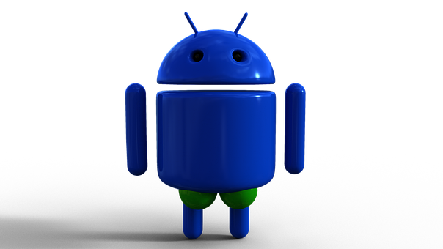
Well bee
~A SMART HEALTH APP
HEALTH-TECH
~ WELL BEE is a smart health app which provides
clinical assistance, health monitoring ,
patient portal, remainder and
communication facilities !

Slide 2
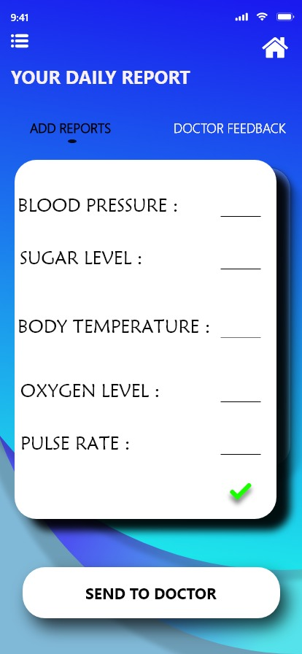
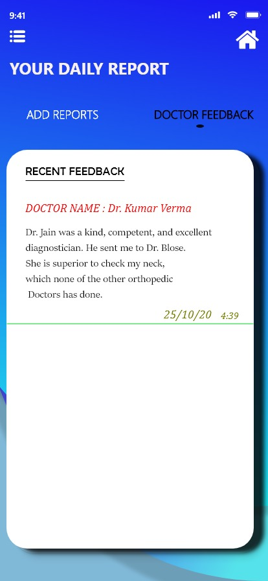
PROBLEM 1: there is no follow up by doctor about patients health once the medicines are given and Lack of health tracker in the industry.
PATIENT CENTERED INFORMATION EXCHANGE SYSTEM
SOLUTION 1:
~Once the patient goes to doctor and he is given medicines for his Ailment he can feed his daily progress in the app about his health that day.
~The patient as well as the doctor can track the Effectiveness of medications over a week or so through graphs and illustrations in their respective
Apps.

Slide 3
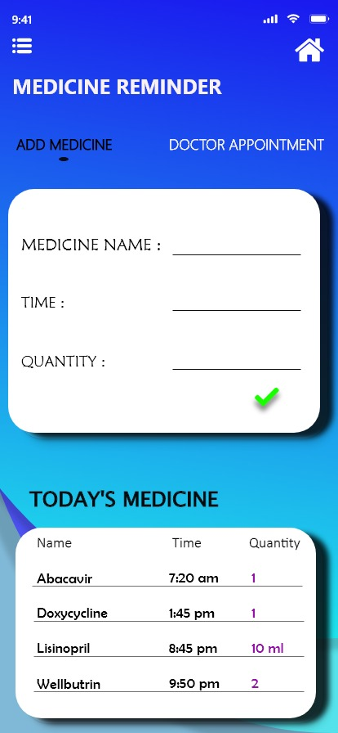
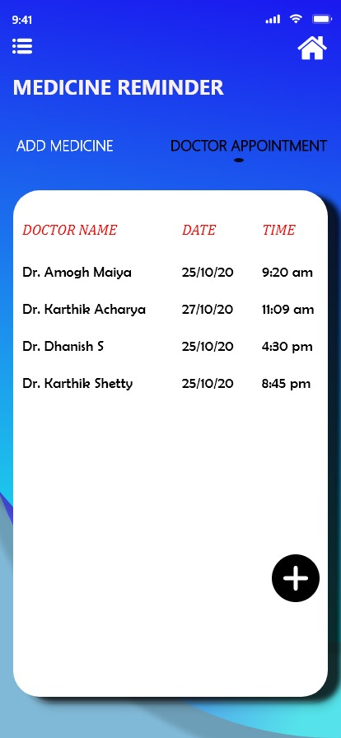
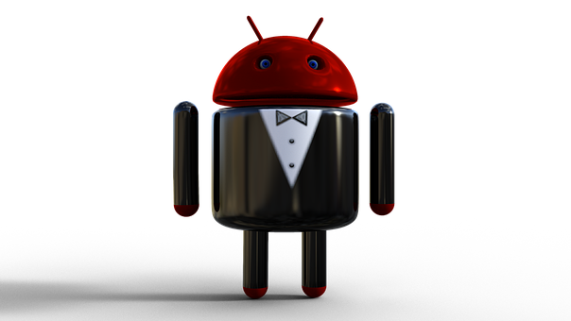
PROBLEM 2:patients often forget to take medications given by doctor which leads to worsen the ailments.
PERSONAL MEDICAL ASSISTANT
SOLUTION 2:
~We have included a simple REMINDER Feature
in the Health App which reminds people to take the medications from time to time!!!

Slide 4
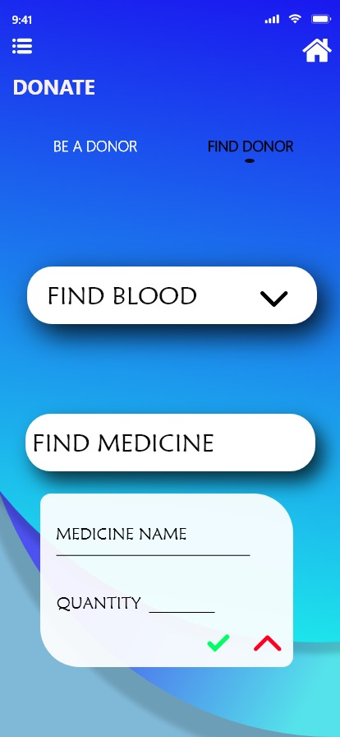
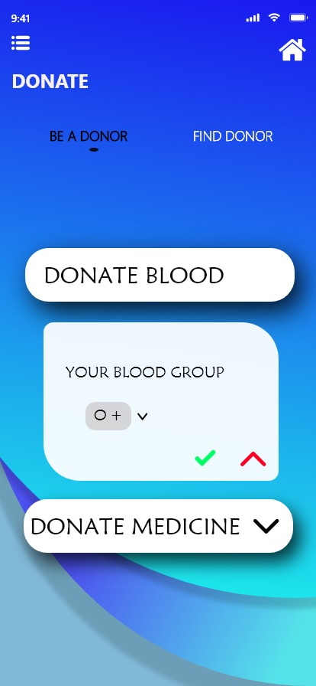
PROBLEM 3:wastage of medicines and lack of awareness among people in social cause
PATIENT CENTERED INFORMATION EXCHANGE SYSTEM
SOLUTION 3:
~DONATION OF MEDICINES:
Generally lot of medicines worth thousands of dollars end up as a waste due several reasons!
~Users can donate unused medicines to needy ones.
~BLOOD DONATION AWARENESS:
~Users get notified whenever there is social cause blood donation campaign & they can wish to
Contribute.

Slide 5
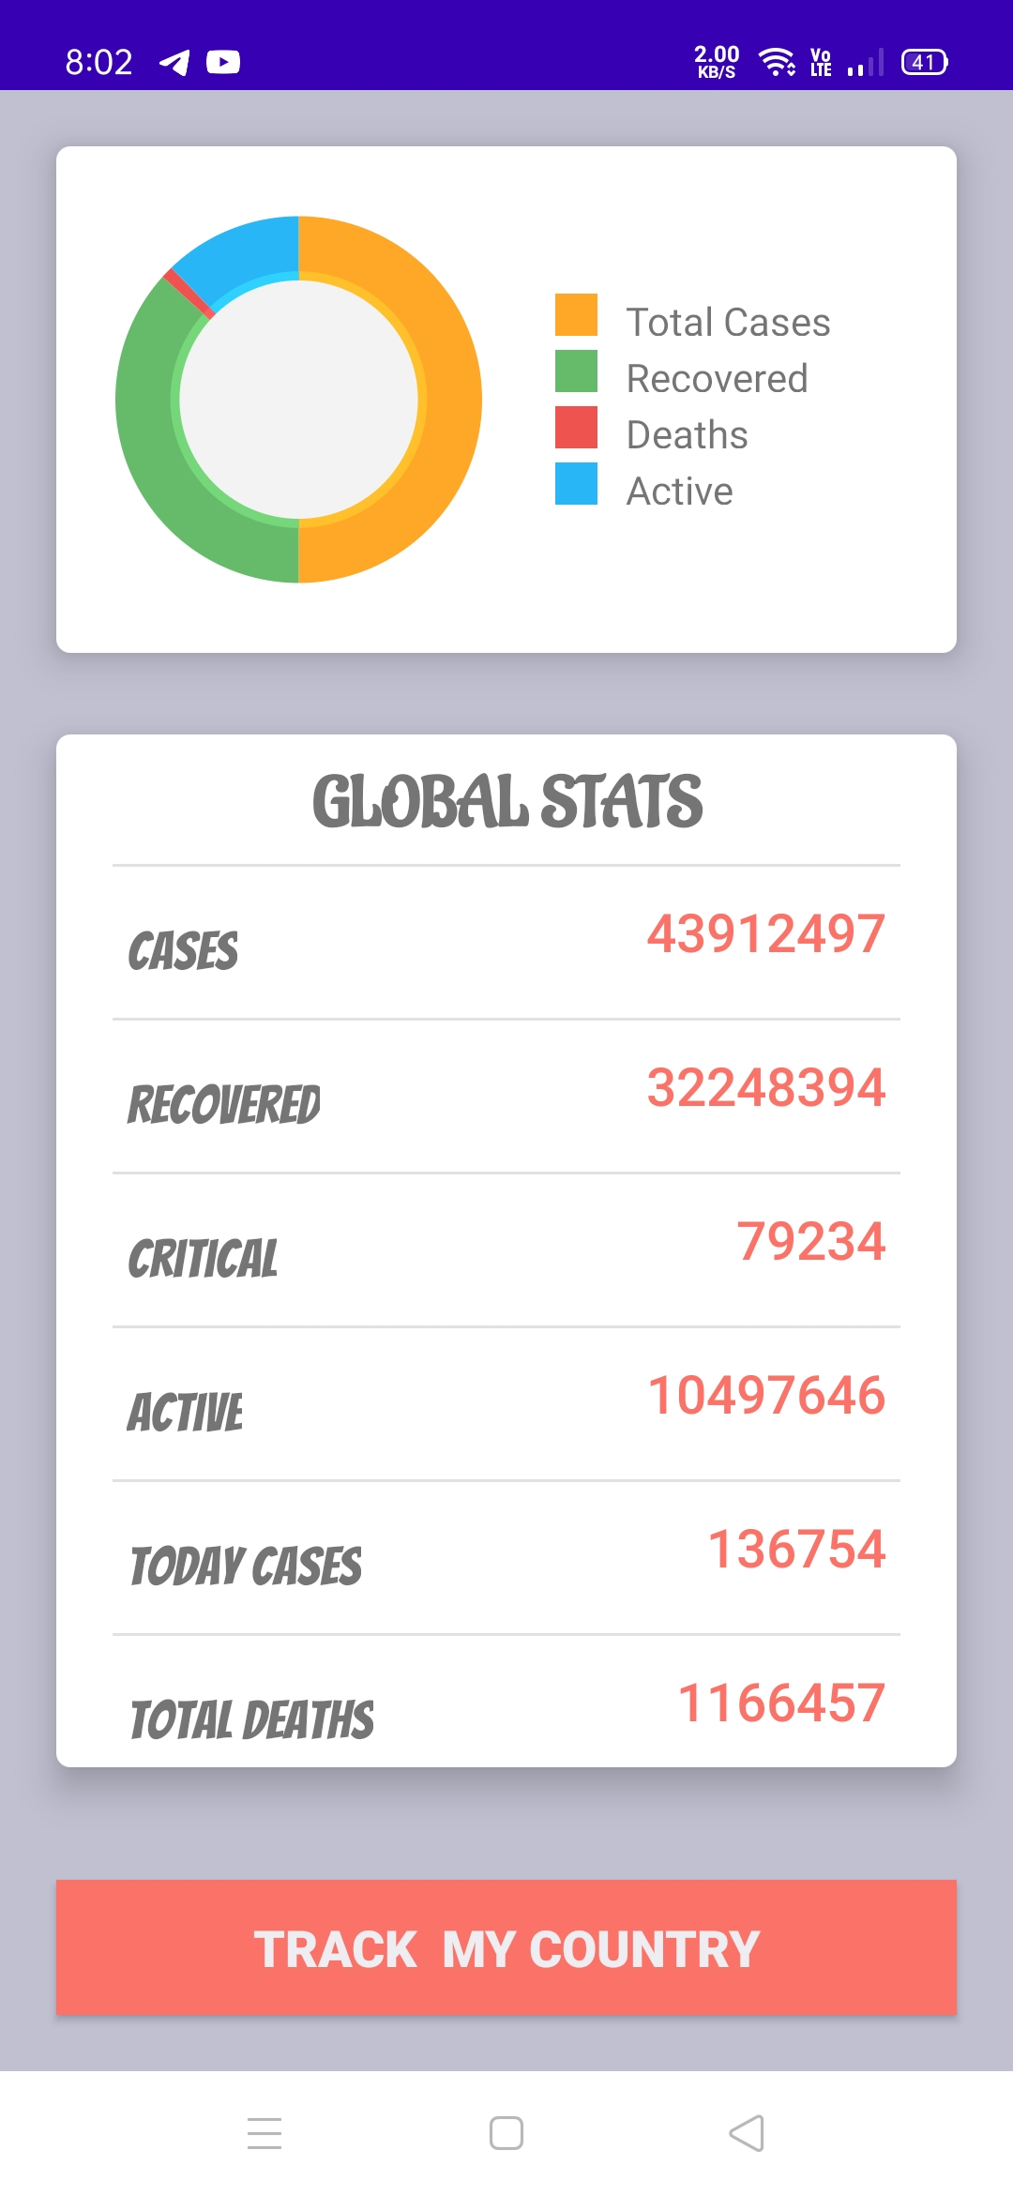
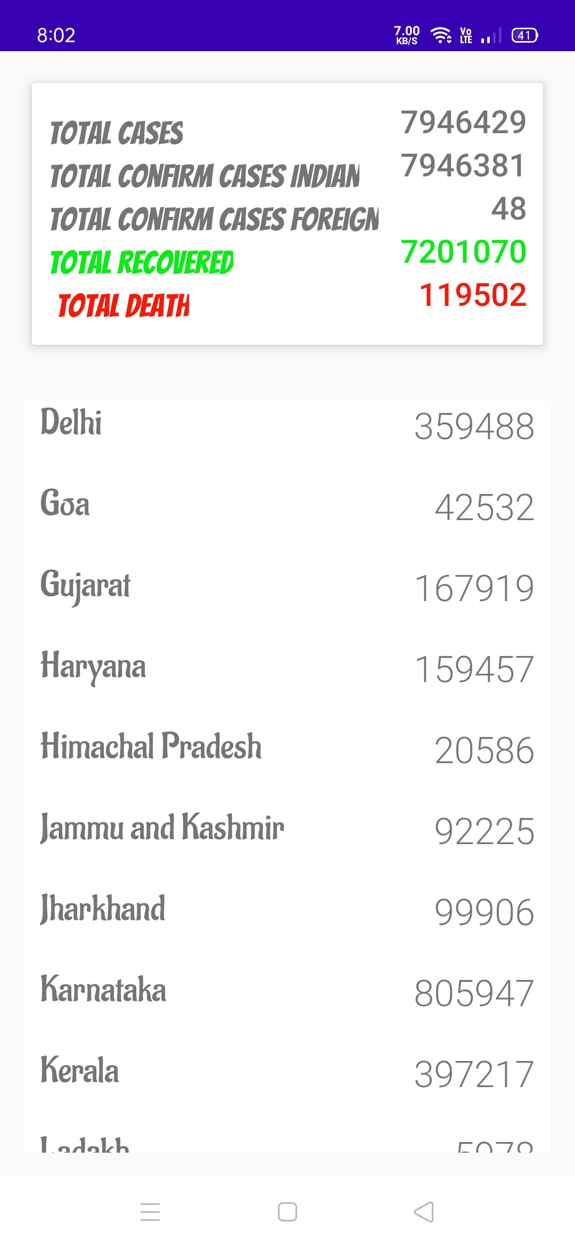
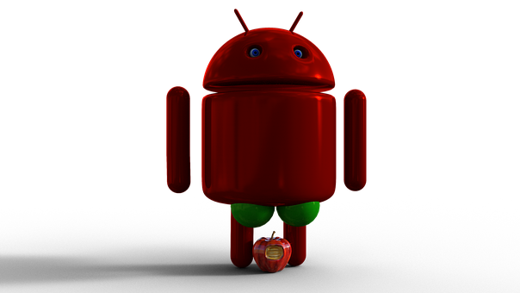
PROBLEM 4:lack of awareness related to covid-19 and medical updates in people.
PERSONAL MEDICAL ASSISTANT
SOLUTION 4:
~Covid-19 updates and awareness in the App.
~Trending medical related updates in the form of
Blog posts and articles for the users.

Slide 6
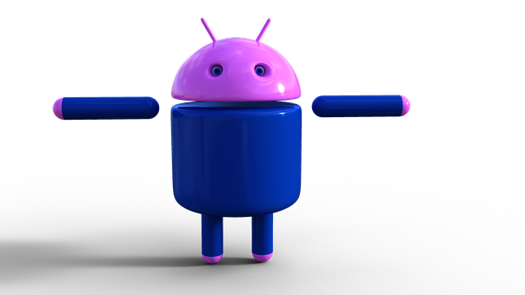
medical assistant chatbot: ~with the help of a simple chatbot we can resolve queries related to the app , problems faced by users and to give a rich user experience!!
PERSONAL MEDICAL ASSISTANT

Slide 7
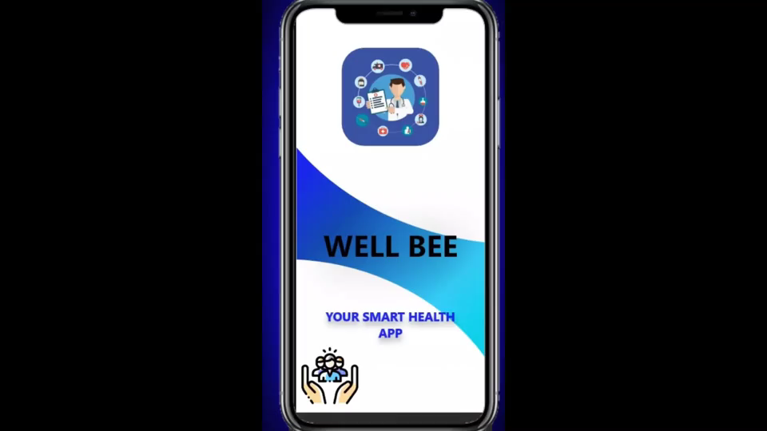
~APP PROTOTYPE PROMO VIDEO

Slide 8

~TEAM WELL BEE

